Slide 1
Used Car Price Prediction
Project Submitted by Ankur Kumar

Slide 2
Table of contents:-
Problem Statement:-With the covid 19 impact in the market, we have seen lot of changes in the car market. Now some cars are in demand hence making them costly and some are not in demand hence cheaper. One of our clients works with small traders, who sell used cars. With the change in market due to covid 19 impact, our client is facing problems with their previous car price valuation machine learning models. So, they are looking for new machine learning models from new data. We have to make car price valuation model.

Slide 3
Data Analysis Steps:-
Import Necessary Libraries
Collection of data from Source
Cleaning of data
Imputing missing values
Visualization
Preprocessing
Model Building
Selecting Appropriate ML Algorithm for the model
Evaluating metrics of the data
Concluding the Error
Saving of the model

Slide 4
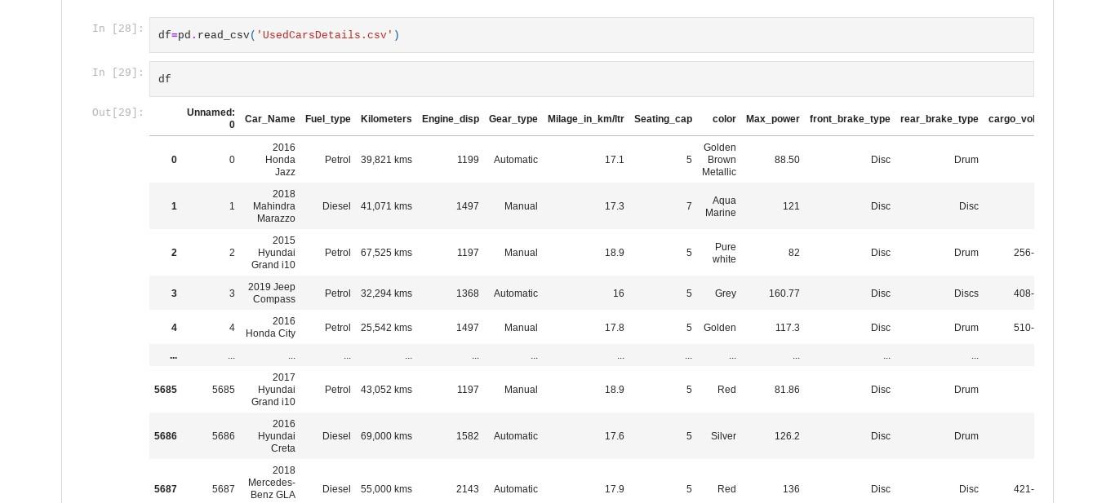
Data Collection:-

Slide 5
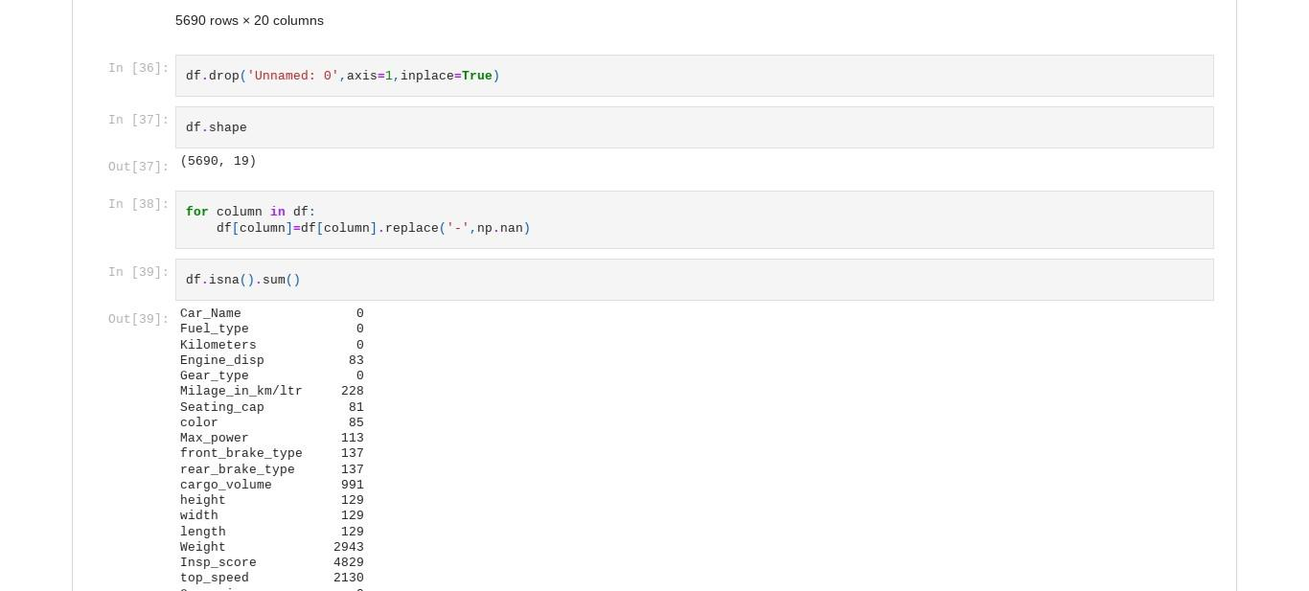
Cleaning of Data:-

Slide 6
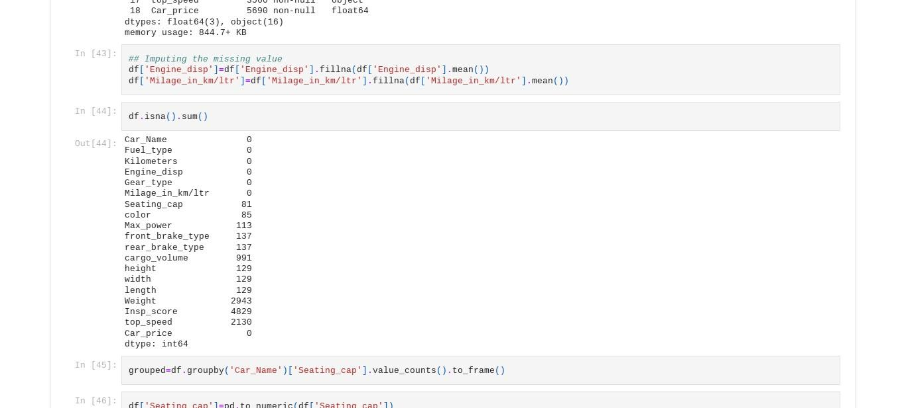
Imputing Missing Values:-

Slide 7
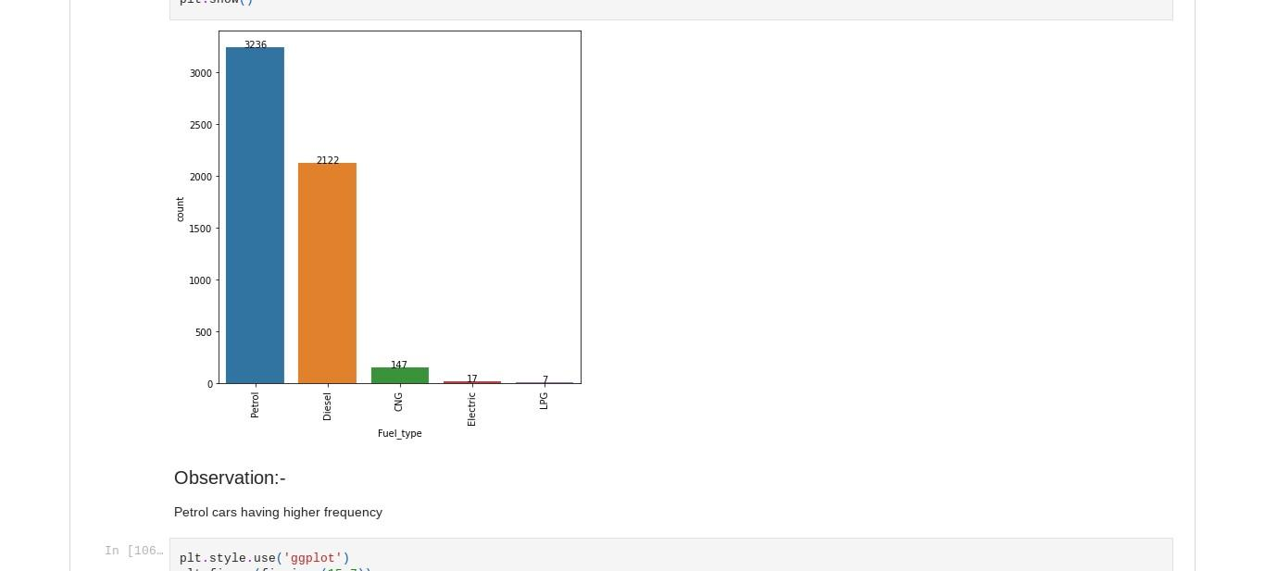
Visualization:-
Univariate Analysis:-

Slide 8
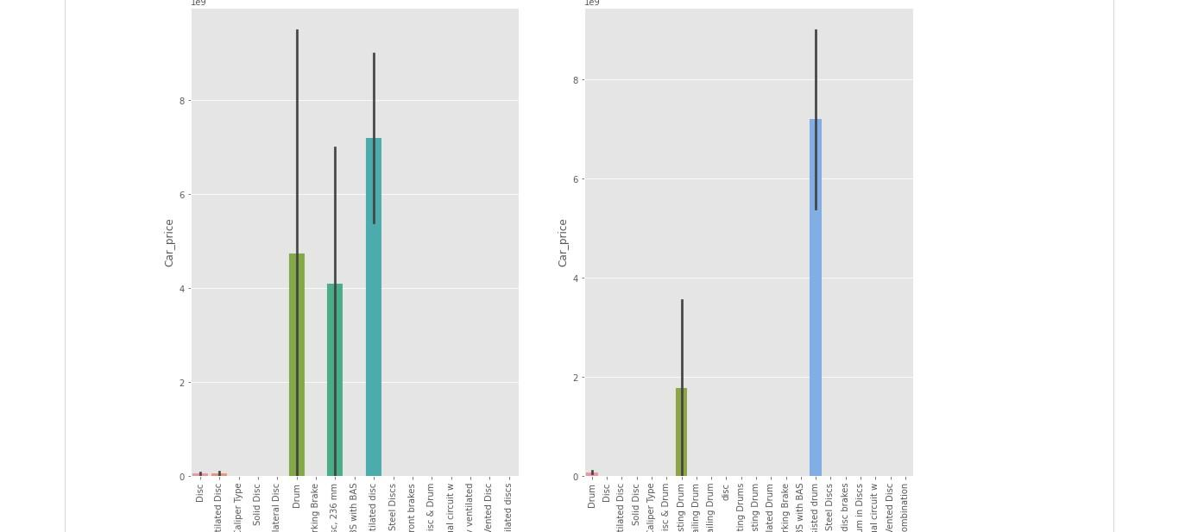
Bivariate Analysis

Slide 9
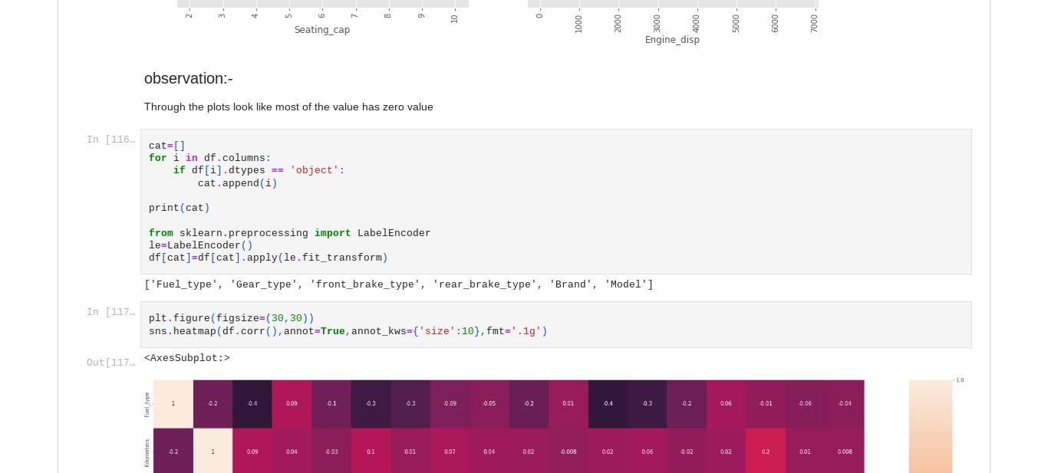
Preprocessing:-

Slide 10
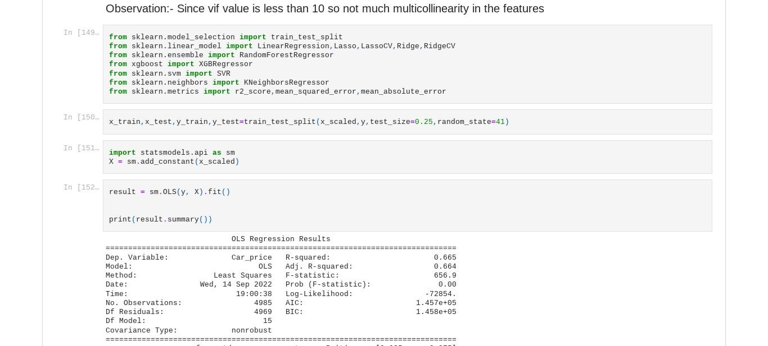
Model Building:-

Slide 11
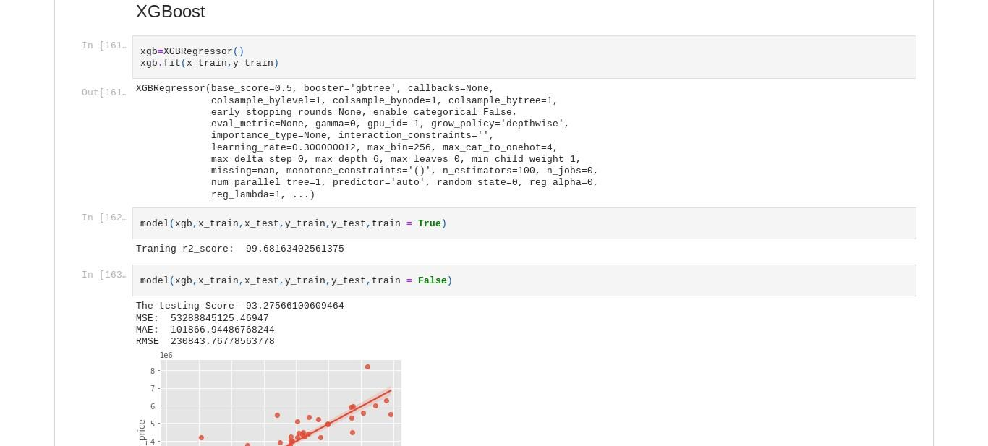
Selecting Appropriate ML Algorithm:-

Slide 12
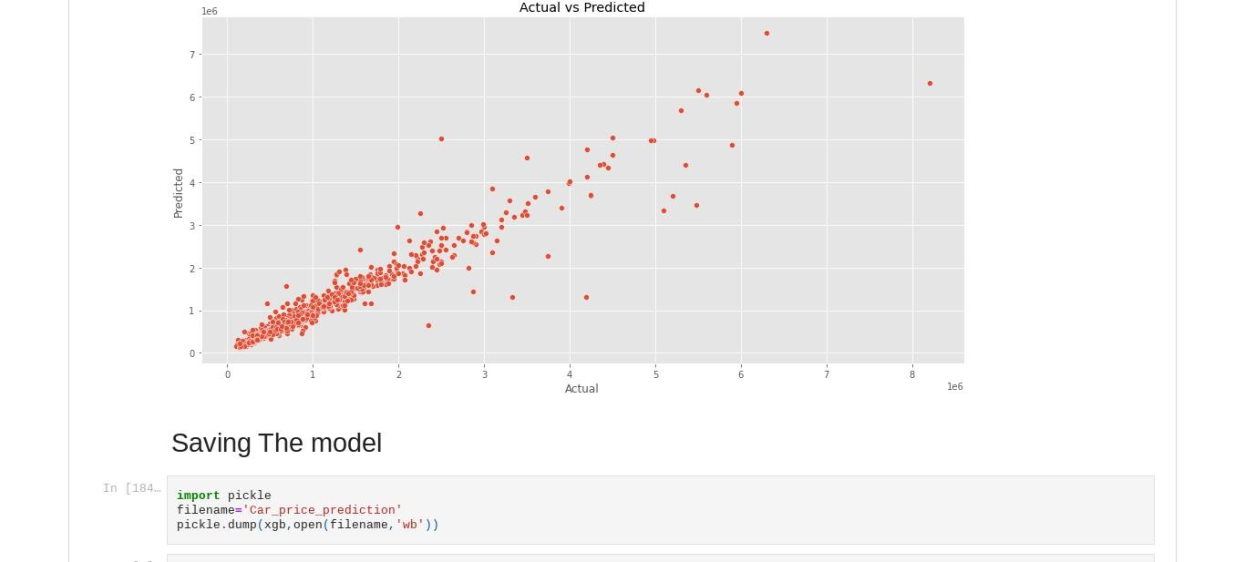
Saving The Model

